Slide 1
CSE 163
Missing Data & Time Series
Hunter Schafer

Slide 2
DataFrame
One of the basic data types from pandas is a DataFrame
It’s essentially a table with column and rows!
Columns
 | id | year | month | day | latitude | longitude | name | magnitude
0 | nc72666881 | 2016 | 7 | 27 | 37.672333 | -121.619000 | California | 1.43
1 | us20006i0y | 2016 | 7 | 27 | 21.514600 | 94.572100 | Burma | 4.90
2 | nc72666891 | 2016 | 7 | 27 | 37.576500 | -118.859167 | California | 0.06
Index (row)

Slide 3
Group By
data.groupby('col1')['col2'].sum()
Data
Split
Apply
(sum)
Combine
key | col2
A | 1
 | 4
key
A | 5
col1 | col2
A | 1
B | 2
C | 3
A | 4
C | 5
key
A | 5
B | 2
C | 8
key | col2
B | 2
key
B | 2
key | col2
C | 3
 | 5
key
C | 8

Slide 4
This Week
Monday
Missing Data
Time Series
Library: pandas
Wednesday
Data Visualization
Library: seaborn
Friday
Machine Learning
Library: scikit-learn
Data Science Libraries

Slide 5
What to Learn
This week, we are learning more about pandas and learning 2 new libraries
Memorizing the function calls and parameters is ridiculous
No one memorizes this stuff!
This is what documentation is for!
Much more important to understand the big ideas behind what the library call is doing
You might use a different library in the future
They change from version to version
Don’t try to write every bit of syntax down, focus on the big ideas behind what we are trying to solve and use the slides and lecture notes as a resource.
On the exam, we will provide shortened documentation so you don’t have to memorize the method calls

Slide 6

fMRI

Slide 7
Missing Data
Demo
Most data in the world is messy and not in a form you want
Most common: Missing data
Pandas uses “Not a Number” (NaN) to represent missing data
Most times, it will just ignore them in computations but NaN can be a common source of bugs!
Useful pandas functions
Detecting for missing data
isnull()
notnull()
Changing/Removing missing data
dropna()
fillna()

Slide 8
Sorting
Demo
Sorting your data is a very common task
Either for presentation or finding the top-k
Very easy in pandas!
Note: All of these return new DataFrames
# Sort data
data.sort_values('column')
data.sort_index()
# Find top-k
data.nlargest(10, 'column')

Slide 9
Keyword Arguments
How does Python know that a is 2 and b is 3?
Arguments are determined by position
Python also allows you to pass by name instead
Library calls usually take MANY arguments (with defaults), much more convenient to specify the ones you by name
def div(a, b):
return a / b
div(2, 3)
div(b=3, a=2)

Slide 10

Brain Break

Slide 11
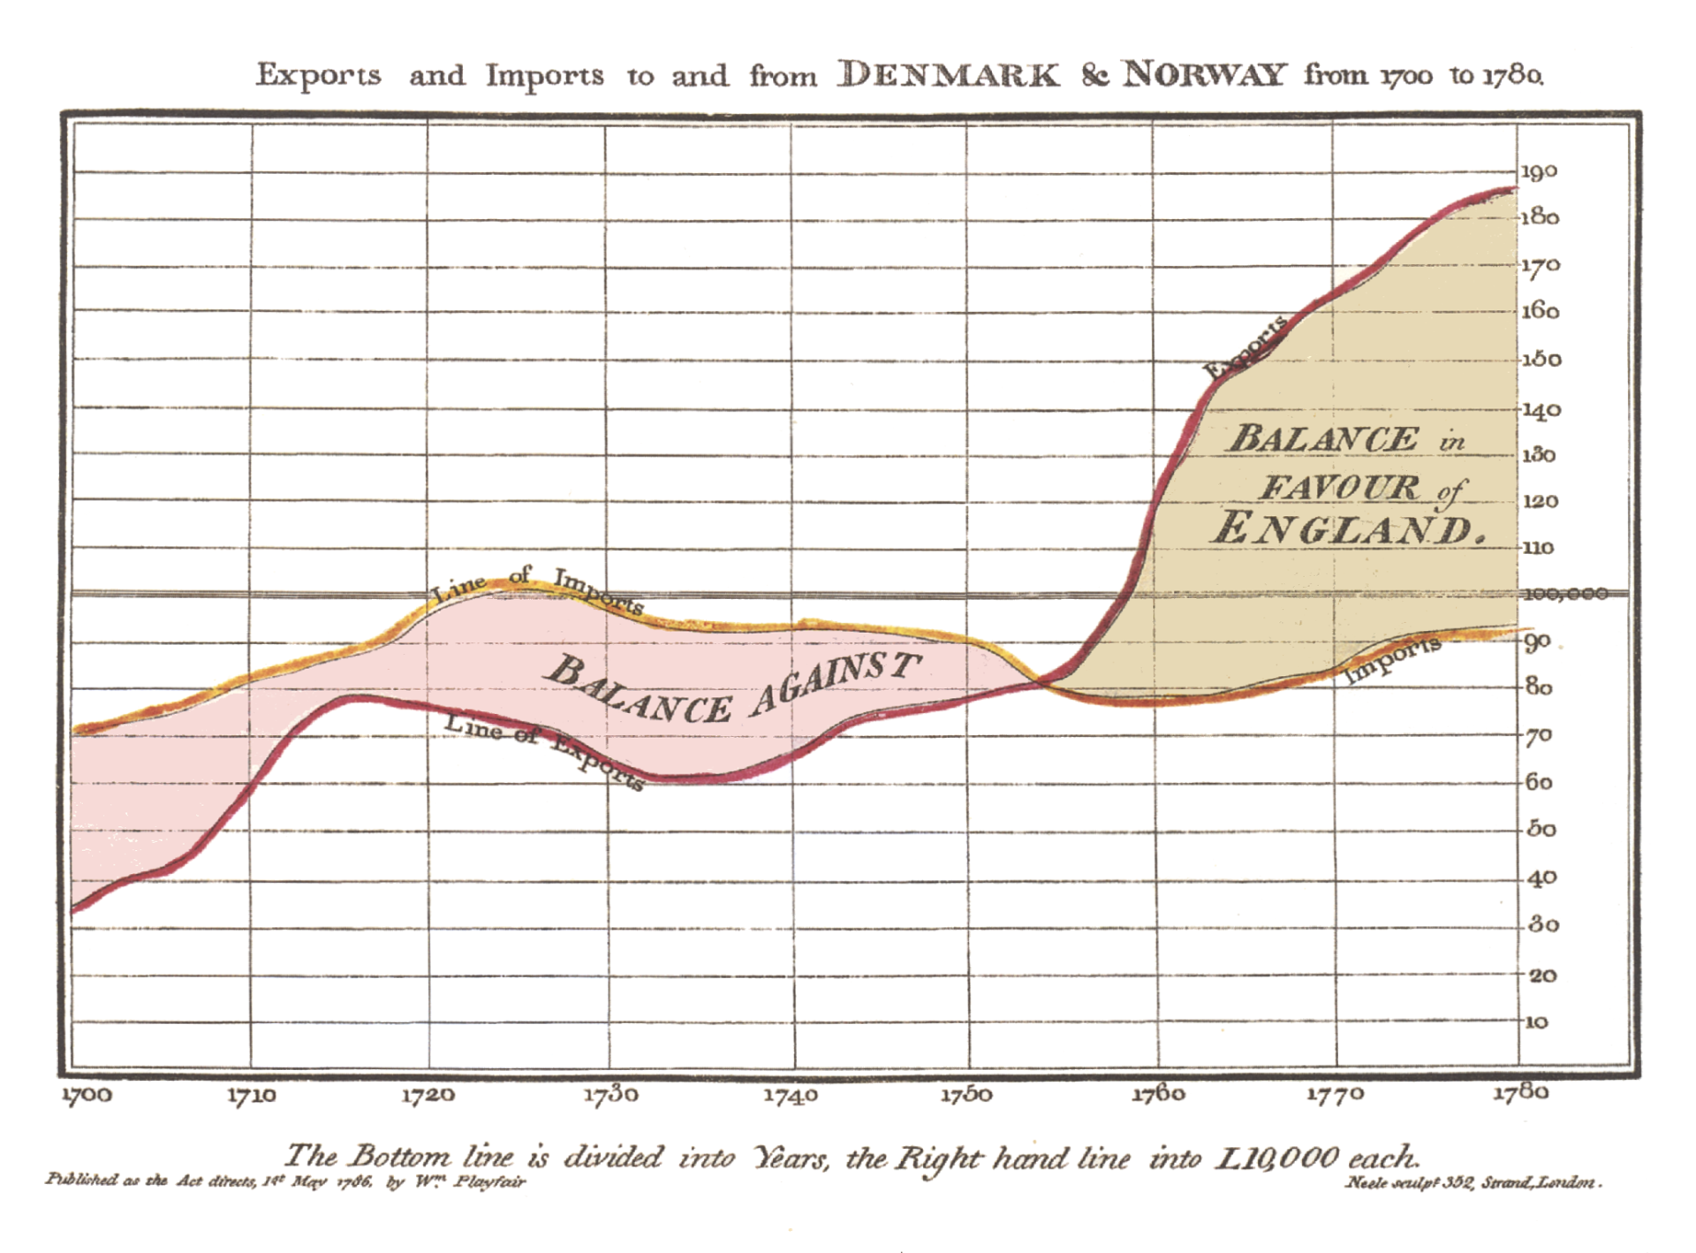
Time Series

Slide 12

Fremont Bridge

Slide 13
Time Series
Demo
Context: A bit more advanced than what you will need on your homework for this week, but can be helpful for your project!
Common to change index of your data to be the timestamp
This allows easy querying by date
# Read in data with timestamp
data = pd.read_csv('data.csv', index_col='col',
parse_dates=True)
# Query for certain dates
data.loc['2017-03-06'] # one day
data.loc['2018-06'] # a month
data.loc['2019'] # a year
data.loc['2017':'2019'] # a range of time

Slide 14
Granularity Matters
Demo
Your data will have a certain granularity to its time
e.g a row per second, a row per hour, a row per year
Your application might require a different granularity
You can downsample by combining values
You can upsample by creating new values
Both are done using resample
Use codes to describe frequency
D = day, W = week, M = month, A = year, …
Many possible codes listed here.
Can also groupby with time, but is not the same as downsampling.

Slide 15
Next Time
Focus on data visualization
How to do it in Python
What is a “good” data viz
Before Next Time
If you haven’t started HW2, now is a great time!

